Slide 1
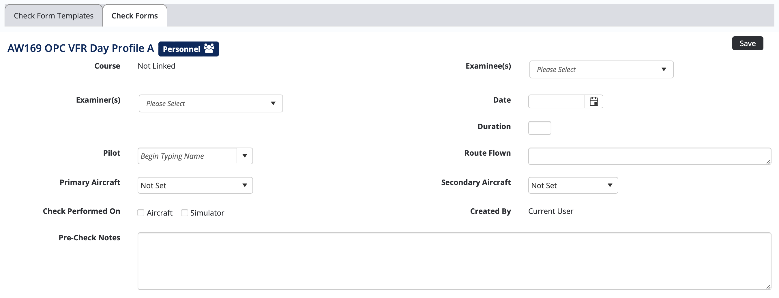
Current Aircraft Headers on a Check Form – Set By Air Maestro

Slide 2







Required Aircraft Headers on a Check Form – Recommended Changes
Free Text Box so a License number can be typed into it.
License Number
Free Text Box
License Number
Free Text Box
Take-Off Time
Landing Time
Take-Off / Landing Time Boxes ( Set Time box 00:00)

